Slide 1
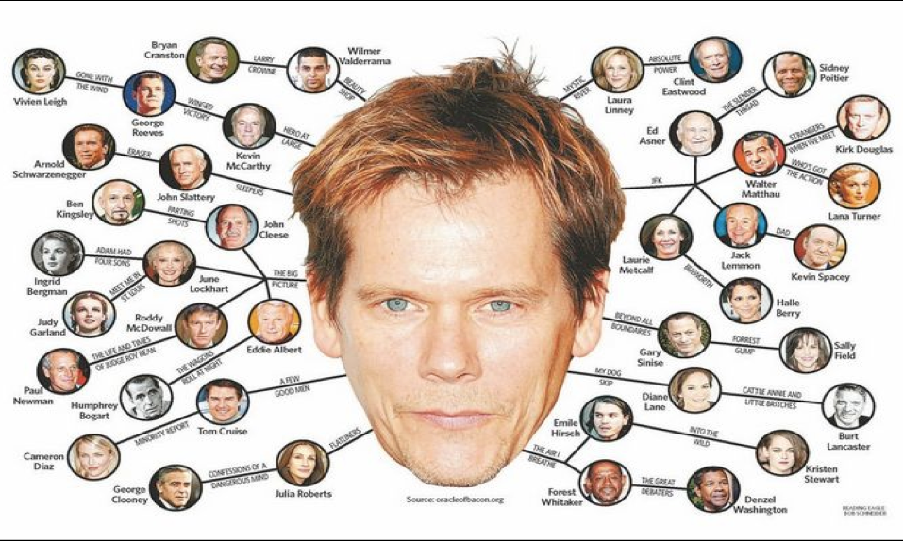
Social Network Analysis
Lab 8
Six (or fewer) degrees of separation
Try for yourself!
Notes:
https://www.kdnuggets.com/2016/02/how-small-is-world-really.html

Slide 2
Agenda
Network vocabulary
Applications for justice
Network analyses in R
Notes:
Some papers and network data sources posted in Lab 8 on Courseworks

Slide 3
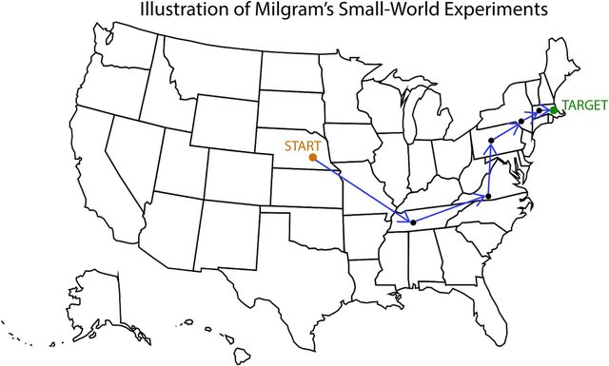
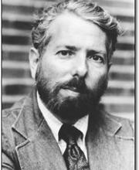
“Small world”
Stanley Milgram
Notes:
Milgram at Yale was famous for obedience/authority experiments, became asst professor at Harvard and conducted famous “small world” experiment, sending letters to target through acquaintances; origin of “six degrees of separation” and set off analyses of social networks

Slide 4
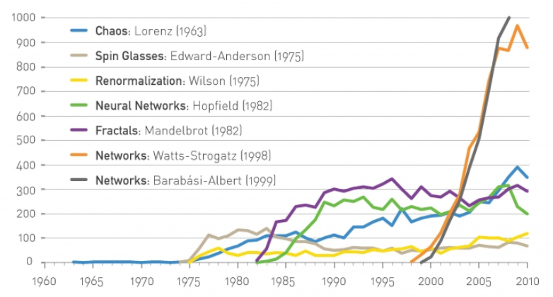
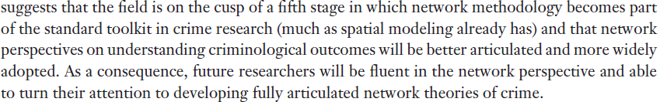
Network science is young but increasingly popular
(Faust & Tita 2019)

Slide 5
Networks = Graphs
B
Edge
Weighted edge
A
Node / Vertex
C
Directed edge

Slide 6
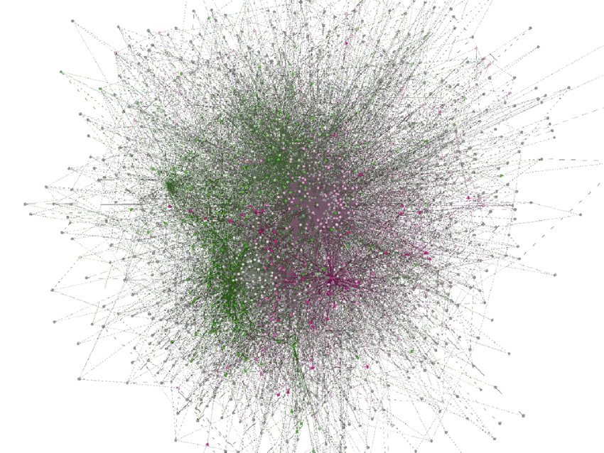
Networks can get big
Notes:
Fig. 8: shows the complete social interactions network of the public Facebook page, "Against Stop Online Piracy Act SOPA", over all the contents shared on the page. At generation time there were 5690 posts, 3864 likes directly on the posts, 8564 comments to the posts and 15529 likes on the posted comments. Clusters are separated by colors. For better visibility all nodes with a degree of lower than six have been removed from the graph; hence; the above graph contains 16% of the total nodes of the original graph and 36% of the total edges of the original graph.

Slide 7
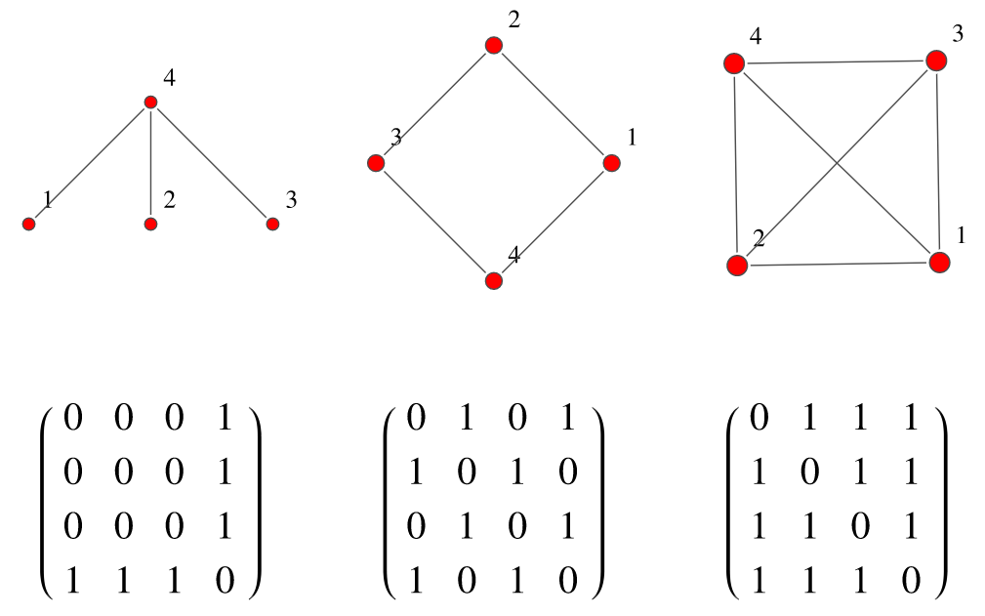
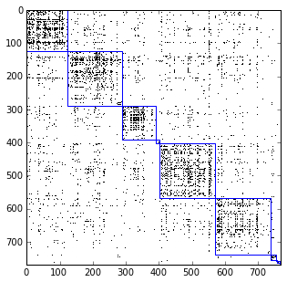
How to represent a network/graph
1 2 3 4
1
2
3
4
Adjacency matrix

Slide 8
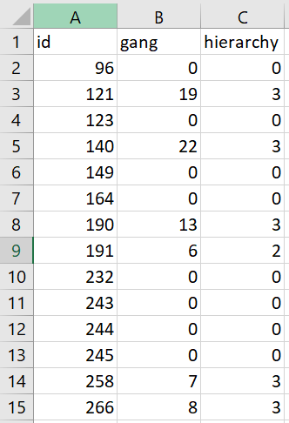
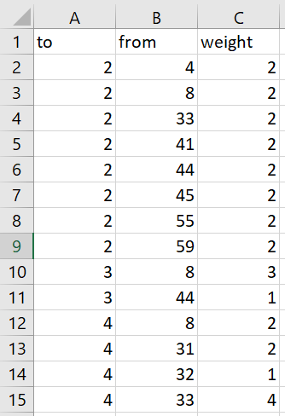
How to represent a network/graph
Node list
Edge list

Slide 9
Descriptive Statistics
Node level
Graph level
B
D
A
C

Slide 10
Node centrality
Numbers/rankings assigned to nodes that measure position in the network
E.g.
Influential people in social network
Key infrastructure nodes in internet or urban networks
Super-spreaders of disease
B
D
A
C

Slide 11
Node centrality
Degree centrality
How many edges in or out
In-degree(A) = 2; Out-degree(A) = 1
Closeness centrality
Avg. shortest path between nodes
Closeness(A) = 1+2+2/3 = 1.7
B
D
A
C

Slide 12
Node centrality
Degree centrality
How many edges in or out
In-degree(A) = 2; Out-degree(A) = 1
Closeness centrality
Avg. shortest path between nodes
Closeness(A) = 1+2+2/3 = 1.7
Betweenness centrality
How many times a node bridges other nodes
Betweenness(C) = 1/2 = 0.5
B
D
A
C

Slide 13
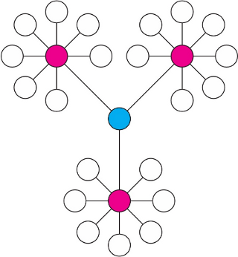
High degree centrality
High betweenness centrality

Slide 14
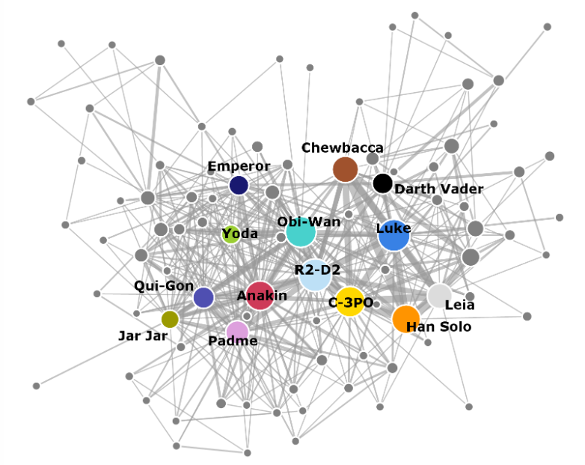
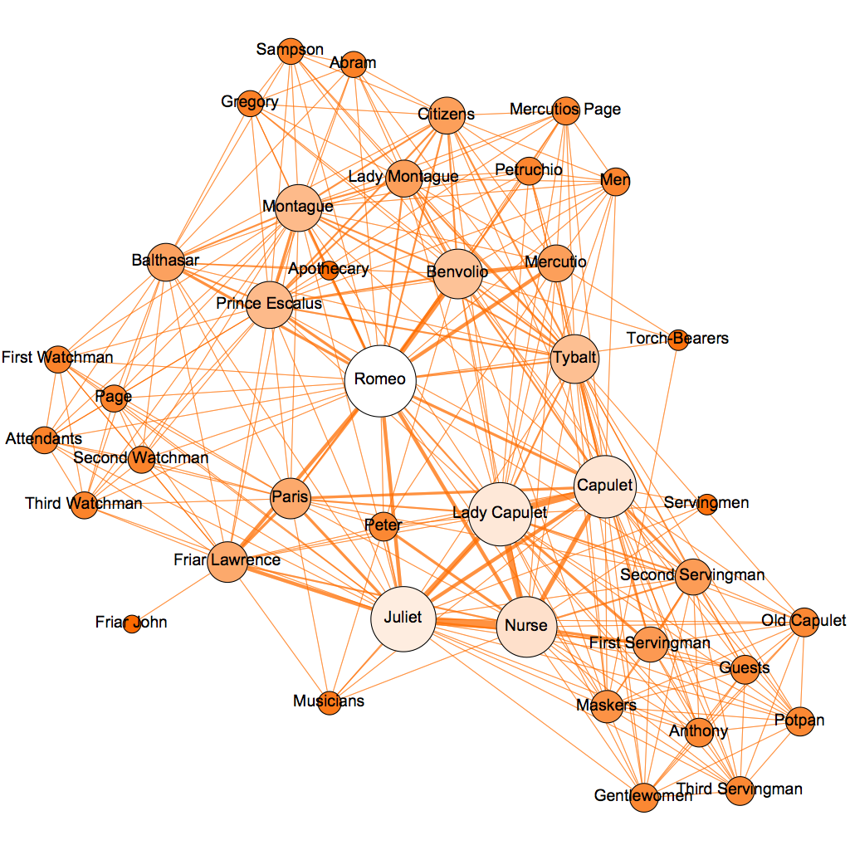
Star Wars (ep. 1-6)
Romeo & Juliet

Slide 15
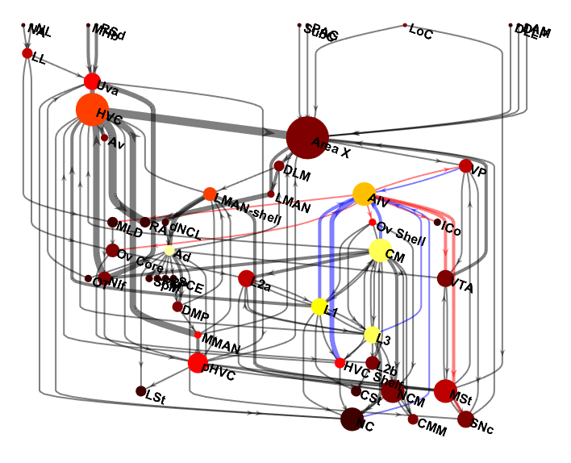
Songbird brain ☺

Slide 16
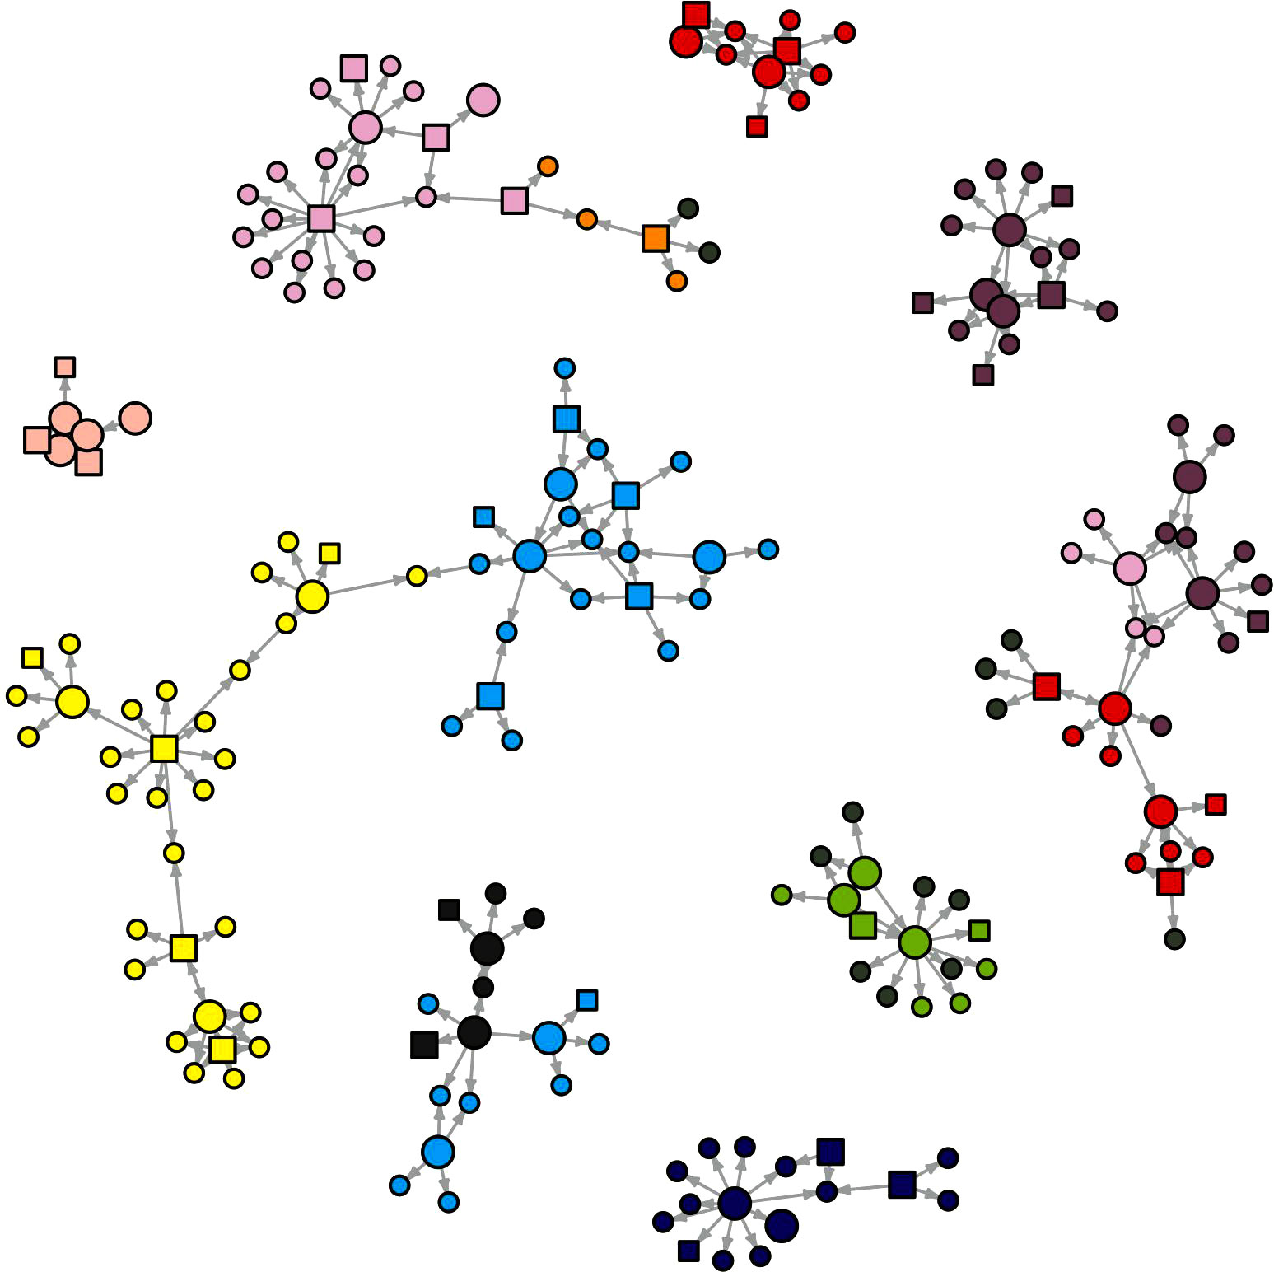
Network cohesion
Connected components
Subgraphs
Clusters
Within-component subgroups
Reciprocity
Proportion of bi-directional edges (for directed graphs)
Path lengths
Average paths among all nodes (degrees of separation)

Slide 17
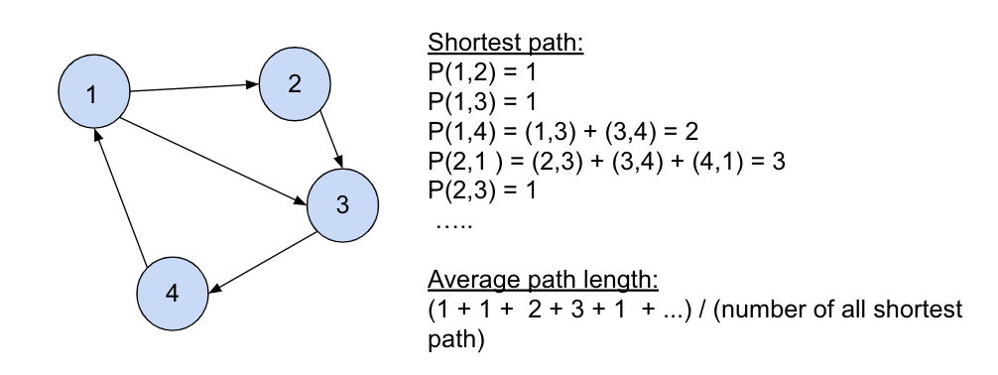
Paths describe flows
E.g. average path length = 6
means 6 degrees of separation

Slide 18
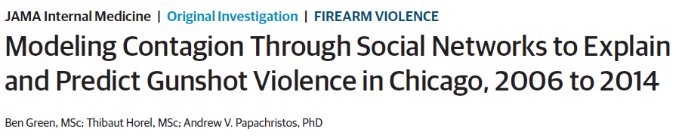
Network analyses in justice data
Gun violence as an “epidemic”
Due to demographics, geography, social network?
link to paper

Slide 19
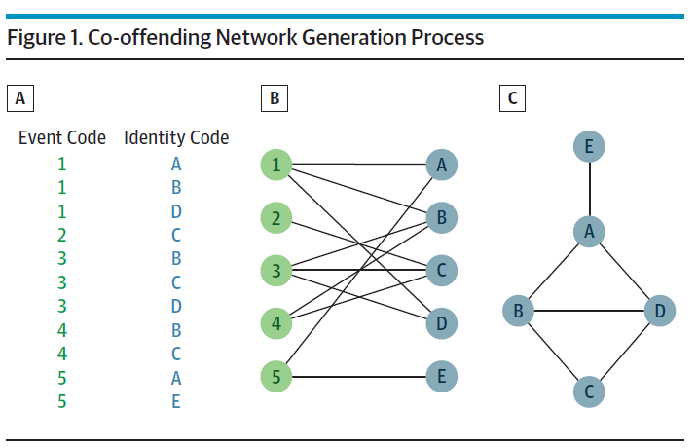
Co-offending network data

Slide 20
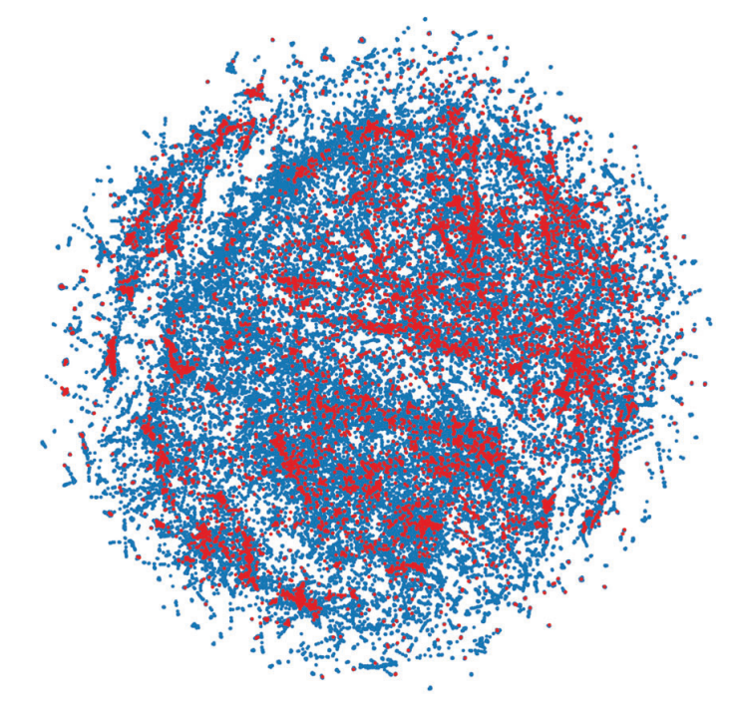
Violence victims are non-randomly dispersed among non-victims
Non-victim
Victim of gun
violence
Notes:
this is their main network, 138,163 nodes (individuals with an arrest record) – edges are not shown (spatially closer points are more connected)

Slide 21
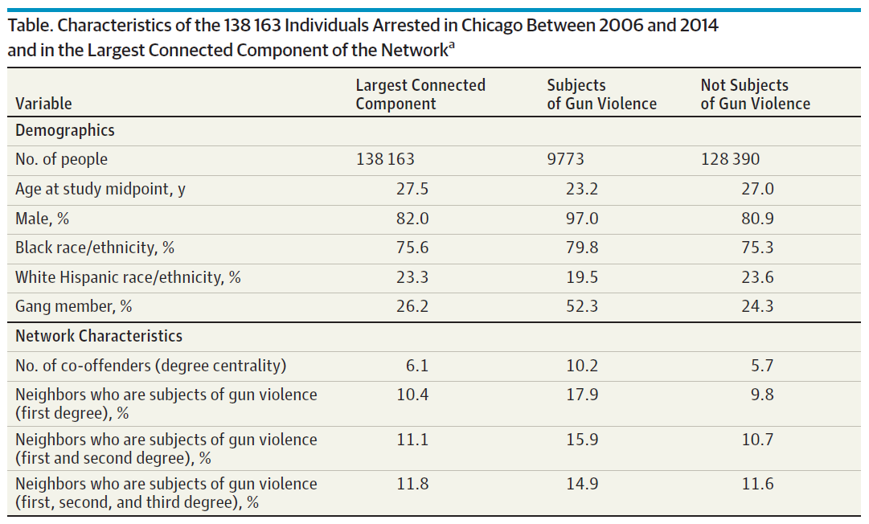
Notes:
gun violence victims had almost twice the connections to other victims as non-victims had to other non-victims

Slide 22
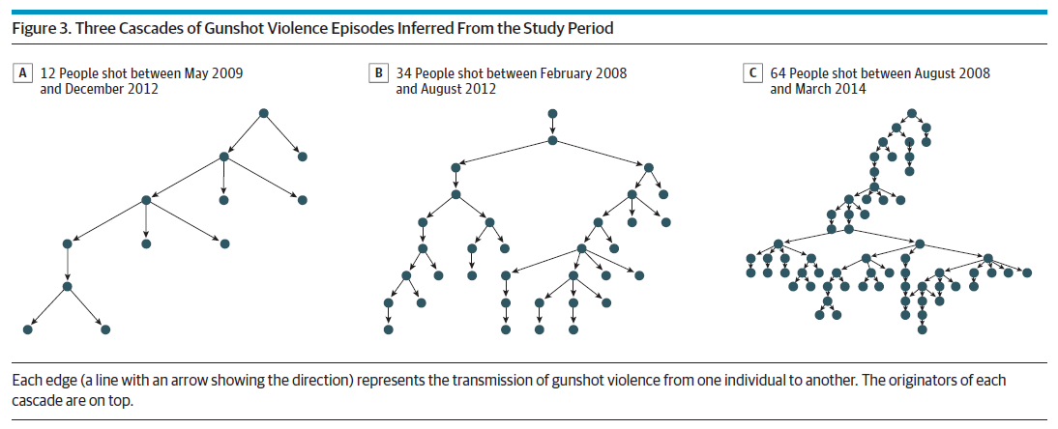
4,107 cascades of gun violence

Slide 23
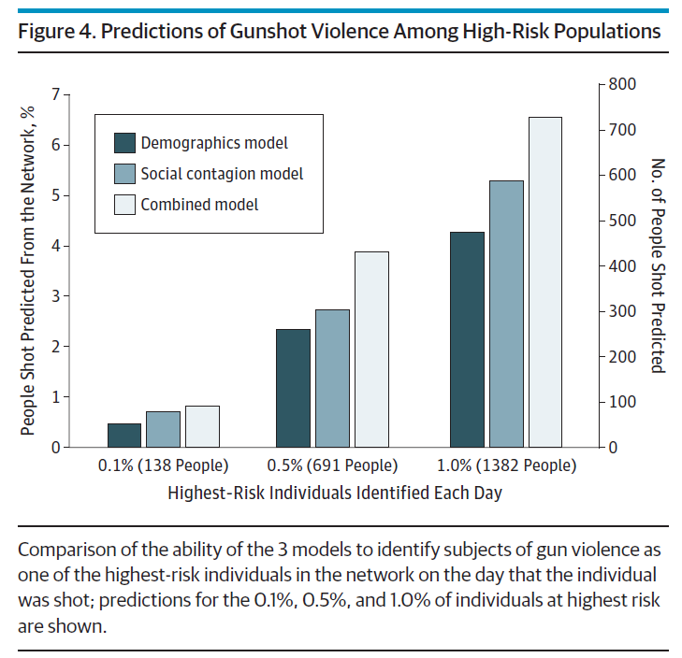
Social contagion accounts for 63% of 11,123 gunshot violence episodes

Slide 24
Extended reading
Deeper reading into general network science
Network Science by Albert-László Barabási
Network analyses applied to justice problems
Social Networks and Crime: Pitfalls and Promises for Advancing the Field (Faust & Tita 2019)
Dealing with network data in R
Statistical Analysis of Network Data with R
Applied Network Science with R e-book

